Slide 1

Batch 4

Slide 2
What is linux ?
It is a Unix like Operating System.
It can run on 32-bit and 64 bit Software.
Linux Os ,is freely distributable, and a cross- platform.
Supports Multiple Processors.
True Multitasking and Multi-User Os.

Slide 3
History of Linux
In 1991, Linus Torvalds a student at the university of Helsinki, Finland, thought to have a freely available academic version of Unix started writing its own code.
Later this project became the Linux kernel.
He wrote this program specially for his own PC as he wanted to use Unix 386 Intel computer but couldn't afford it. He did it on MINIX using GNU C compiler. GNU C compiler is still the main choice to compile Linux code but other compilers are also used like Intel C compiler.
He started it just for fun but ended up with such a large project. Firstly he wanted to name it as 'Freax' but later it became 'Linux'.
Linux uses most of its tools from GNU software and are under GNU copyright. In 1992, he released the kernel under GNU General Public License.

Slide 4
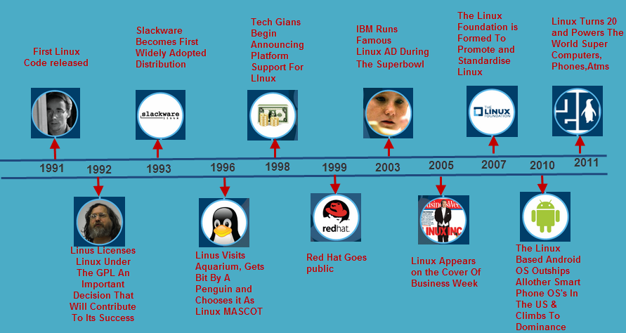

Slide 5
Language used:
The core components of Linux like Drivers, Kernels are written in C language.
The GNU parts of the Linux OS are also written in ANSI C, including the compiler itself (gcc) and glibc.

Slide 6
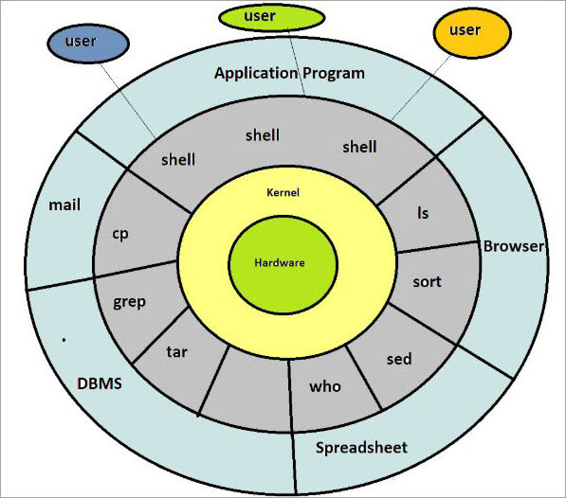
Architecture:

Slide 7
Linux Architecture:-
Kernel: Kernel is the core of the Linux based operating system. It virtualizes the common hardware resources of the computer to provide each process with its virtual resources. This makes the process seem as it is the sole process running on the machine. The kernel is also responsible for preventing and mitigating conflicts between different processes.
Types -
Monolithic Kernel
Hybrid kernels
Micro kernels

Slide 8
Linux Architecture (contd.):-
System Library: It is the special types of functions that are used to implement the functionality of the operating system.
Shell: It is an interface to the kernel which hides the complexity of the kernel’s functions from the users. It takes commands from the user and executes the kernel’s functions.
Hardware Layer: This layer consists all peripheral devices like RAM/ HDD/ CPU etc.
System Utility: It provides the functionalities of an operating system to the user.

Slide 9
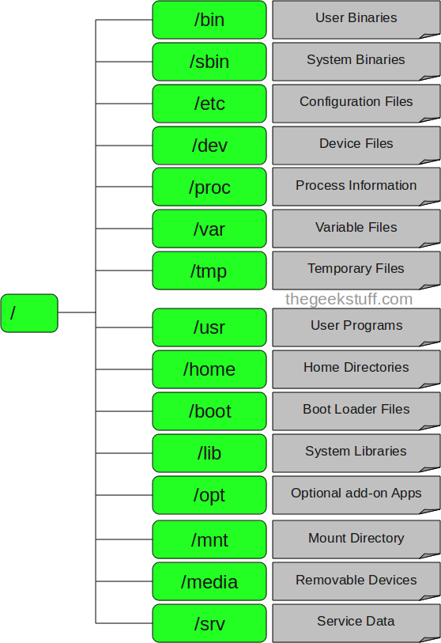
Linux File Structure
Root

Slide 10
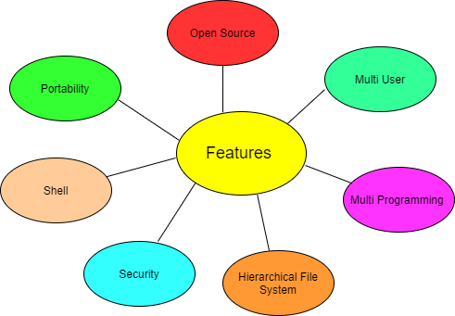
Features of Linux OS:-

Slide 11
Why linux is called secure ?
Linux Security provides core security capabilities for Linux environments: multi-engine anti-malware with vital Integrity Checking for endpoints and servers.
Provides protection against unauthorized access within the corporate network
Can protect your mixed environment against both Windows and Linux malware
Scans malware on mail servers, web servers and file servers, as well as endpoints
Protects system files against unauthorized modifications
Extensive monitoring and alerting functions to notify administrators about infected content
Easy deployment and management with Policy Manager, even for multiple servers
Superior detection rates with multiple scanning engines

Slide 12
Basic commands:
$ show the terminal.
In linux commands commands follow a general syntax.
$<command name> [option]
1. pwd command
Use the pwd command to find out the path of the current working directory (folder) you’re in. The command will return an absolute (full) path, which is basically a path of all the directories that starts with a forward slash (/). An example of an absolute path is /home/username.
Syntax - $pwd [options]
Options
-L (logical) - Use PWD from environment, even if it contains symbolic links
-P (physical) - Avoid all symbolic links
-help - Display this help and exit
-version - Output version information and exit

Slide 13
Basic commands (contd.):
2. cd command
To navigate through the Linux files and directories, use the cd command. It requires either the full path or the name of the directory, depending on the current working directory that you’re in.
Another scenario is if you want to switch to a completely new directory, for example,/home/username/Movies. In this case, you have to type cd followed by the directory’s absolute path: cd /home/username/Movies.
Syntax - $ cd [option]
Options
cd .. (with two dots) to move one directory up
cd or cd ~ to go straight to the home folder
cd- (with a hyphen) to move to your previous directory

Slide 14
Basic commands (contd.):
3. ls command
The ls command is used to view the contents of a directory. By default, this command will display the contents of your current working directory.
If you want to see the content of other directories, type ls and then the directory’s path. For example, enter ls /home/username/Documents to view the content of Documents.
Syntax - $ls [option]
Option-
ls -R will list all the files in the sub-directories as well
ls -a will show the hidden files
ls -al will list the files and directories with detailed information like the permissions, size, owner, etc.

Slide 15
Basic commands (contd.):
4. cat command
cat (short for concatenate) is one of the most frequently used commands in Linux. It is used to list the contents of a file on the standard output (sdout). To run this command, type cat followed by the file’s name and its extension. For instance: cat file.txt.
Syntax - $cat [option]<filename>
Here are other ways to use the cat command:
$cat > filename - creates a new file
$cat filename1 filename2>filename3 - joins two files (1 and 2) and stores the output of them in a new file (3)
$cat filename | tr a-z A-Z >output.txt - to convert a file to upper or lower case use.
$cat filename - display single file
$cat file1 file 2 - display multiple files

Slide 16
Basic commands (contd.):
$cat -n filename - line number in file output
$cat -s filename - suppress repeated lines
$cat file1 >> file2 - append the contents of one file to the end of another file.
$tac filename - display content in reverse order using tac command.
$cat -E "filename" -can highlight the end of line.
$cat -- "-dashfile" - open dashed files.
$cat "filename" | more - show that much content, which could fit in terminal and will ask to show more.
$cat *.txt - display the content of all text files in the folder.

Slide 17
Basic commands (contd.):
5. cp command
It is used to copy files from the current directory to a different directory.cp stands for copy. It creates an exact image of a file on a disk with different file name. cp command require at least two filenames in its arguments.
Syntax - $ cp [options] source dest
Options
$cp -a -archive files
$cp -f -force copy by removing the destination file if needed
$cp -i -interactive - ask before overwrite
$cp -l -link files instead of copy
$cp -L -follow symbolic links
$cp -n -no file overwrite
$cp -R -recursive copy (including hidden files)
$cp -u -update - copy when source is newer than dest
$cp -v -verbose - print informative messages

Slide 18
Basic commands (contd.):
6. mv command
It is used to move files, although it can also be used to rename files.It moves group of files to different directory.
No additional space is consumed on a disk during renaming. This command normally works silently means no prompt for confirmation..
Syntax - $ mv [options] source dest
Options
$mv -f - force move by overwriting destination file without prompt
$mv -i - interactive prompt before overwrite
$mv -u - update - move when source is newer than destination
$mv -v - verbose - print source and destination files
$man mv - help manual

Slide 19
Basic commands (contd.):
7. mkdir command
It is used to make a new directory.With mkdir, you can also set permissions, create multiple directories (folders) at once, and much more.
Syntax- mkdir [option] dir_name
Options
mkdir directory_name -Creates a directory in the current location
mkdir {dir1,dir2,dir3,dir4} -Creates multiple directories in the current location. Do not use spaces inside {}
mkdir –p directory/path/newdir -Creates a directory structure with the missing parent directories (if any)
mkdir –m777 directory_name -Creates a directory and sets full read, write, execute permissions for all users
mkdir –v directory_name(s) -Creates a directory in the current location

Slide 20
Basic commands (contd.):
8. head command
The head command, as the name implies, print the top N number of data of the given input. By default, it prints the first 10 lines of the specified files.
Syntax: head [OPTION]... [FILE]...
Options
$head -n num <filename > : Prints the first ‘num’ lines instead of first 10 lines. num means number of lines.
$head -c num <filename> : Prints the first ‘num’ bytes from the file specified.

Slide 21
Basic commands (contd.):
9. tail command
The tail command, as the name implies, print the last N number of data of the given input. By default it prints the last 10 lines of the specified files.
Syntax: $tail [OPTION]... [FILE]...
Options
$tail <filename> - display last 10 lines of file
$tail +n <file_name>,-data will start printing from line number ‘n’ till the end of the file specified.
$tail -n num <file name> - display last ‘num’ lines instead of last 10 lines. num is mandatory to be specified in command otherwise it displays an error.
$tail -c num <file_name> - Prints the last ‘num’ bytes from the file specified.

Slide 22
Basic commands (contd.):
10. touch command
It is used to create a file without any content. The file created using touch command is empty. This command can be used when the user doesn’t have data to store at the time of file creation.
Syntax - $touch <filename> - we can create multiple files
Options
$touch filename -a - change the access time only
$touch filename -c - if the file does not exist, do not create it
$touch filename -d - update the access and modification times
$touch filename -m -change the modification time only
$touch filename -r - use the access and modification times of file
$touch filename -t -creates a file using a specified time

Slide 23
Basic commands (contd.):
11. rm command
rm stands for remove here. rm command is used to remove objects such as files, directories, symbolic links and so on from the file system like UNIX.
Syntax - rm [OPTION]... FILE...
Options
-f, --force -ignore nonexistent files, never prompt
-i - prompt before every removal
-I - prompt once before removing more than three files, or when removing recursively.
--interactive[=WHEN] -prompt according to WHEN: never, once (-I), or always (-i).
--one-file-system - removing a hierarchy recursively, skip any directory that is on a file system different from that of the corresponding command line argument.
--no-preserve-root -do not treat `/' specially
--preserve-root - do not remove `/' (default)
-r, -R, --recursive - remove directories and their contents recursively

Slide 24
Basic commands (contd.):
12. file command
Used to determine the type of a file. .file type may be of human-readable(e.g. ‘ASCII text’) or MIME type(e.g. ‘text/plain; charset=us-ascii’). This command tests each argument in an attempt to categorize it.
Syntax - file [option] [filename]
Options -
$file -b filename : This is used to display just file type in brief mode.
$file * <option> :Command displays the all file’s file type.
$file directoryname/* option : This is used to display all files file types in particular directory.
$file [range]* option: To display the file type of files in specific range.
$file -c option: Cause a checking printout of the parsed form of the magic file.
$file -f option: Read the names of the files to be examined from namefile (one per line) before the argument list. Either namefile or atleast one filename argument must be present; to test the standard input, use ‘-’ as a filename argument.
$file -F option : File and file type are separated by :. But we can change separator using -F option.

Slide 25
Basic commands (contd.):
13 . rename command
It is used to rename the named files according to the regular expression perlexpr. It can change the name of the multiple files.
Syntax - rename [options] expression replacement file...
Options
$rename -s: This option renames the files ignoring the symbolic links.
$rename -v: This option is used to show which files is being renamed, if there is any.
$rename -n : This option comes into play when the user wants to see only the final change.
$rename -o : This option will not going to overwrite the existing files.
$rename -V: This option will show the version information and exit.

Slide 26
Basic commands (contd.):
14. grep command
The 'grep' command stands for "global regular expression print". grep command filters the content of a file which makes our search easy.The 'grep' command is generally used with pipe (|).
Syntax: command | grep <searchWord>
Options :
grep -v : The 'grep -v' command displays lines not matching to the specified word.
grep -i : The 'grep -i' command filters output in a case-insensitive way.
grep -A : The grep -A command is used to display the line after the result.
grep -B : The grep -B command is used to display the line before the result.
grep -C : The grep -C command is used to display the line after and line before the result.

Slide 27
Basic commands (contd.):
15 .vi command
The vi editor opens in this mode, and it only understands commands. In this mode, you can, move the cursor and cut, copy, paste the text. This mode also saves the changes you have made to the file
Syntax - $vi <filename_NEW> or <filename_EXISTING>
Supporting commands -
i - Insert at cursor (goes into insert mode)
a - Write after cursor (goes into insert mode)
A - Write at the end of line (goes into insert mode)
ESC - Terminate insert mode
u - Undo last change
U - Undo all changes to the entire line
o - Open a new line (goes into insert mode)
dd - Delete line

Slide 28
Basic commands (contd.):
3dd - Delete 3 lines.
D - Delete contents of line after the cursor
C - Delete contents of a line after the cursor and insert new text. Press ESC key to end insertion.
dw - Delete word
4dw - Delete 4 words
cw - Change word
x - Delete character at the cursor
r - Replace character
R - Overwrite characters from cursor onward
s - Substitute one character under cursor continue to insert
S - Substitute entire line and begin to insert at the beginning of the line
~ - Change case of individual character

Slide 29
Basic commands (contd.):
16. ping command
The ping command stands for (Packet INternet Groper). It checks the connectivity between two nodes that is whether a server is reachable or not. ping command keep executing and sends the packet until you interrupt.
To stop from execution press ctrl + c.
Syntax : $ping [OPTIONS] DESTINATION
Example : $ping javatpoint.com
You can use IP address also with ping command.
Example: ping 2.2.2.2
Option :
-c : To limit the ping packet without using ctrl + c use option c followed by the number of packet to be send.
Syntax: $ping -c <number> <destination>

Slide 30
Basic commands (contd.):
17. cal command
cal command shows current month calendar as output.
cal command is a calendar command in Linux which is used to see the calendar of a specific month or a whole year.
Syntax - $cal <month> <year>

Slide 31
Basic commands (contd.):
18. Sudo Command
The sudo command allows you to run programs with the security privileges of another user (by default, as the superuser). It prompts you for your personal password and confirms your request to execute a command by checking a file, called sudoers , which the system administrator configures.
Syntax - $sudo [option]
Options
$sudo -V: The -V (version) option causes sudo to print the version number and exit. If the invoking user is already root, the -V option will print out a list of the defaults sudo was compiled with.
$sudo -l: The -l (list) option will print out the commands allowed (and forbidden) the user on the current host.
$sudo -h or –help: The -h (help) option causes sudo to print a usage message and exit.
$sudo -v: If, given the -v (validate) option, sudo will update the user’s timestamp, prompting for the user’s password if necessary.
$sudo -k: The -k (kill) option to sudo invalidates the user’s timestamp.So, the next time sudo is run a password will be required.

Slide 32
Basic commands (contd.):
19. Man command
The "man" is a short term for manual page. In unix like operating systems such as linux, man is an interface to view the system's reference manual.A user can request to display a man page by simply typing man followed by a space and then argument. Here its argument can be a command, utility or function. A manual page associated with each of these arguments is displayed.
Syntax of man: man [option(s)] keyword(s)
But generally [option(s)] are not used. Only keyword is written as an argument.
Options :
$man -aw -List all available sections of a command.
$man -a - To view all man pages of a command.
$sman -k (apropos) - Shows a list of results in man page containing a keyword match.
$man -f, whatis - It displays description from manual page if available.

Slide 33
THANK YOU

